Slide 1



Featuring the event App for
Download CrowdCompass AttendeeHub
Search ISDA & Select Today’s Event
Password
Log-in to access all features
1
2
DC17
3
VIEW agenda, speaker info & attendee list | SUBMIT questions for panelists and answer polls
DOWNLOAD & print documents & presentations | CONNECT with other attendees

Slide 2


ISDA Washington Policy Conference 2017
Monday September 18, 2017 | 10.00am-10.15am
US Public Policy: 2017 and Beyond
Scott O’Malia – CEO, ISDA

Slide 3










Slide 4
Featuring the event App for
Download CrowdCompass AttendeeHub
Search ISDA & Select Today’s Event
Password
Log-in to access all features
1
2
DC17
3
VIEW agenda, speaker info & attendee list | SUBMIT questions for panelists and answer polls
DOWNLOAD & print documents & presentations | CONNECT with other attendees

Slide 5
Derivatives Public Policy Area Of Most Interest?
A: Capital rules
B: Margin requirements
C: Data reporting and standardization
D: Cross-border harmonization
E: Trading requirements
F: Clearing and CCP resolution

Slide 6
Capital Increase - Level of CET1 and CET1 Ratio of G-SIBs
CET 1 amount in billions of euros
CET1 ratio %
Source - S&P Global Market Intelligence

Slide 7
Collateral Posted – Cleared and Non-cleared Derivatives (March, 2017)
Non-cleared Derivatives (Posted by Market Participants to Top 20 Dealers)
Cleared Derivatives (Posted by Market Participants to CCPs)

Slide 8
Interest Rate Derivatives Cleared Notional Volume (%)
79.6%
72.9%
74.7%
79.9%
83.9%
85.2%
88.5%
Q2
Q4
Q2
Q4
Q2
Q4
Q2
2014
2015
2016
2017

Slide 9

Progress Toward G-20 Derivatives Reform Goals
Clearing of all standardized OTC derivatives through central counterparties
Reporting of all OTC derivatives transactions to trade repositories
Execution of all standardized OTC derivatives on exchanges or electronic trading platforms, where appropriate
Margining of non-cleared derivatives
Strengthening of capital framework

Slide 10

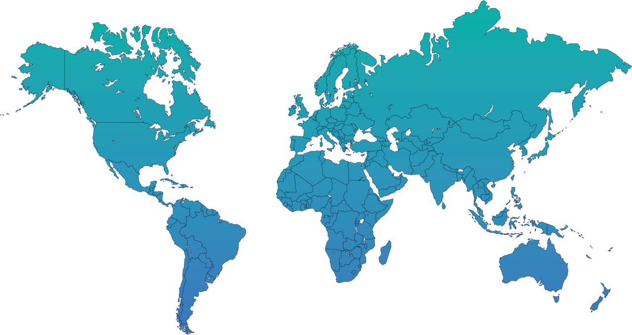

Cross-border Recognition – What’s at Stake

Slide 11
Capital Rules Priorities
No net increase in capital levels, as directed by G-20 members
Appropriate, risk sensitive and consistent
Harmonized on a cross-border basis to avoid global inconsistency
Simplified to reduce operational complexity

Slide 12
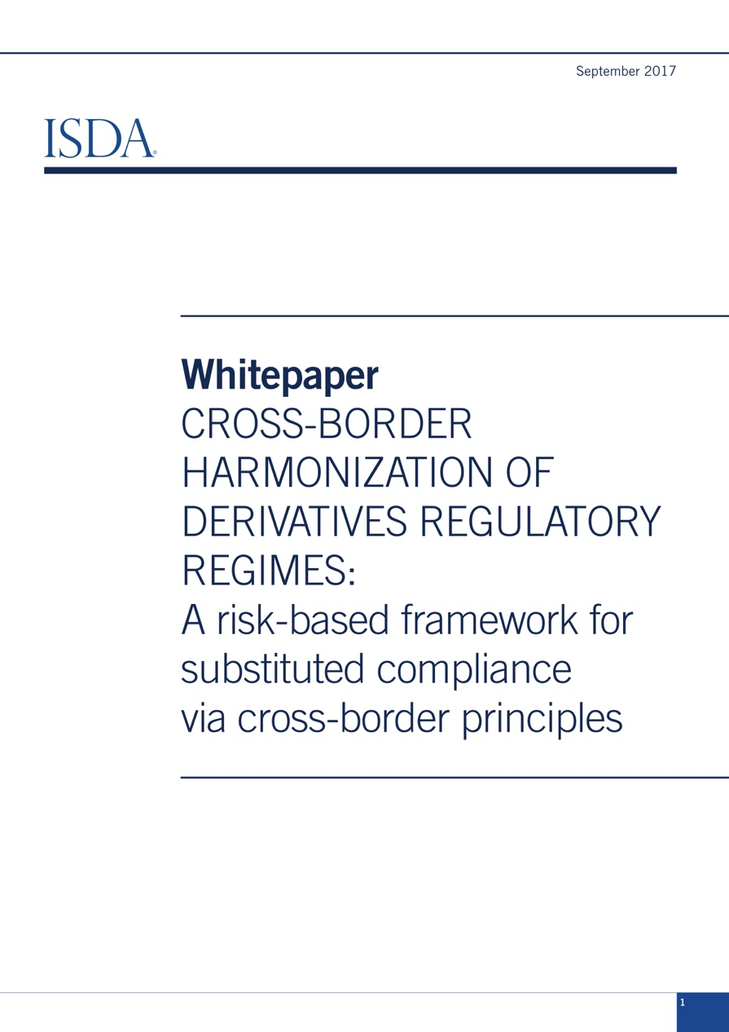
Cross-border Harmonization
Risk-based Principles
Foreign regulators should adopt capital and margin rules consistent with international standards
Foreign regulators should have risk management rules
Foreign regulators should have rules on effective recordkeeping
Foreign regulators should have access to reportable swap data
Foreign jurisdictions should have BIS-IOSCO compliant CCPs and clearing mandates that achieve similar outcomes

Slide 13
CCP Recovery and Resolution
Recommendations
Clearing participants should have maximum transparency over key elements of, and triggers for, a CCP resolution
VM gains haircutting could be used to allocate losses at the end of a CCP’s default waterfall, subject to safeguards
IM haircutting should never be permitted
Partial tear-ups could be used to rebalance a CCP’s book if an auction fails to do so, subject to safeguards
Forced allocation of positions to non-defaulting clearing members should never be permitted

Slide 14
Thank You

